Slide 1
Working with binary file formats
Øyvind Kallstad

Slide 2
Agenda
Binary File Format
Parsing
Examples
Endianness
Helpful .NET classes
Reading Binary Data
Creating a PNG Parser
Writing Binary Data

Slide 3
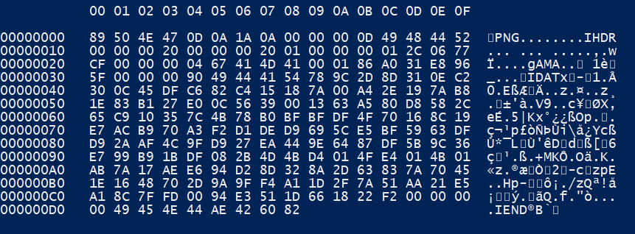
Binary File Format
A binary file format is any file format that contains primarily binary data (compiled applications, images, media, compressed files etc.)
As opposed to a text file format (ascii), if you try to read a binary file you get "gibberish" back
Notes:
get-content .\TestImages\oi1n0g16.png –raw
get-content .\TestImages\oi1n0g16.png -Encoding Byte
get-content .\TestImages\oi1n0g16.png -raw | Format-Hex
Ascii representation of binary data looks like junk data. Get-Content is primarily used to get ascii data, and Windows will give binary data an ascii representation – Use format-hex

Slide 4
View binary file
Notes:
viewBinaryFile.ps1

Slide 5
Parsing
When we talk about reading the contents of a text file, we think in terms of characters or strings
But when reading the contents of binary files, we think in terms of bytes
To make sense of the data in a binary file format, we need some application or script that can parse (translate) the contents.
To make your own binary file format parser you need to have kind of understanding of the structure of the file format in question
Notes:
Good example of general file format structure at: http://hackworthy.blogspot.no/2013/01/how-to-write-binary-file-format.html

Slide 6
Examples
LNK: SHELL_LINK_HEADER [LINKTARGET_IDLIST] [LINKINFO] [STRING_DATA] *EXTRA_DATA
Notes:
Each section also have their own structure

Slide 7
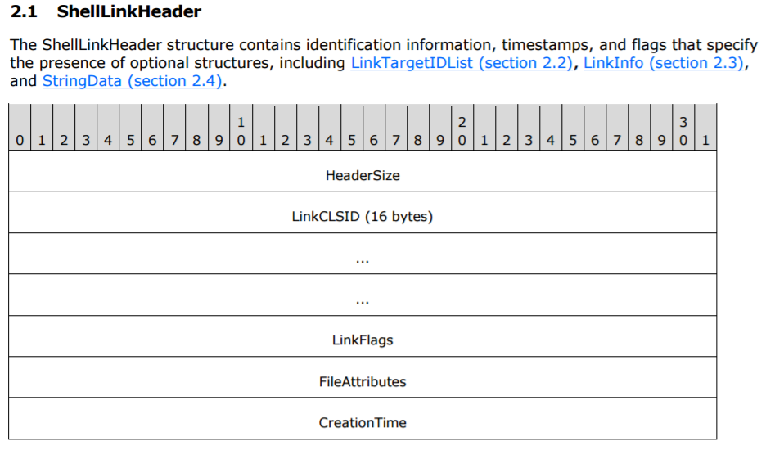
Examples
Notes:
NOTE! Only partial structure!

Slide 8
Examples
PNG: PNG_SIGNATURE [CHUNK] * n

Slide 9
Examples
Chunk layout:
LENGTH + CHUNK TYPE + CHUNK DATA + CRC
or
LENGTH (=0) + CHUNK TYPE + CRC

Slide 10
Examples
Critical chunks
Shall appear in this order, except PLTE is optional
IHDR (shall be first)
PLTE (before first IDAT)
IDAT (multiple allowed - chunks must be consecutive)
IEND (shall be last)

Slide 11
Examples
Ancillary chunks
Need not appear in this order
cHRM (Before PLTE and IDAT)
gAMA (Before PLTE and IDAT)
iCCP (Before PLTE and IDAT. If the iCCP chunk is present, the sRGB chunk should not be present.)
sBIT (Before PLTE and IDAT)
sRGB (Before PLTE and IDAT. If the sRGB chunk is present, the iCCP chunk should not be present.)
bKGD (After PLTE; before IDAT)
hIST (After PLTE; before IDAT)
tRNS (After PLTE; before IDAT)
pHYs (Before IDAT)
sPLT (Before IDAT - multiple allowed)
tIME
iTXt (multiple allowed)
tEXt (multiple allowed)
zTXt (multiple allowed)

Slide 12
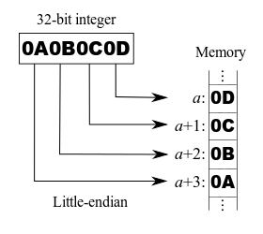
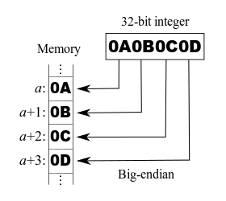
Endianness
Sequencial order used to interpret a range of bytes
Big-endian (most significant bit first)
Little-endian (least signigicant bit first)

Slide 13
Endianness
To check endianness:
[System.BitConverter]::IsLittleEndian

Slide 14
Helpful .NET classes
System.IO.FileStream
System.IO.BinaryReader
System.BitConverter
System.Text.Encoding
System.Array

Slide 15
Reading binary data
BinaryReader methods:
Read (read specified number of bytes, starting from specified point in the stream)
ReadByte (read the next byte from the stream)
ReadBytes (read specified number of bytes, from the current position)
ReadUInt16 (read 2 bytes unsigned little-endian)
ReadUInt32 (read 4 bytes unsigned little-endian)
ReadUint64 (read 8 bytes unsigned little-endian) Will advance the current position!

Slide 16
Reading binary data
BinaryReader.BaseStream (System.IO.Stream)
Length
Position
Seek (Go to position in stream)
PowerShell method:
Get-Content –Encoding Byte

Slide 17
Reading binary data
Notes:
Test2.ps1

Slide 18
Creating a PNG parser
Find, read and understand the file format documentation
https://www.w3.org/TR/PNG/
Plan your code (pseudo code is your friend here!)
Implement
Write separate parsers for each data section!
Test and verify

Slide 19
PNG parser
Notes:
Test.ps1

Slide 20
Writing binary data - make your own file format
System.IO.BinaryWriter
Example of String to Byte Array conversion:
[System.Text.Encoding]::ASCII.GetBytes('PowerShell')
Example of Int to Byte Array conversion:
[System.BitConverter]::GetBytes(99)
Use end-of-file marker
Have size fields in section blocks
http://hackworthy.blogspot.no/2013/01/how-to-write-binary-file-format.html

Slide 21
Summary
Know how to work with .NET classes
Get documentation
Get example files
Perservere

Slide 22
Next Steps...
Now: 15 min break
Grab a coffee
Stay here to enjoy next presentation
Change track and switch to another room
Ask us questions or meet me in a breakout session room afterwards

Slide 23
Questions?

Slide 24
Resources
LNK file format: https://winprotocoldoc.blob.core.windows.net/productionwindowsarchives/MS-SHLLINK/[MS-SHLLINK].pdf
PNG file format: https://www.w3.org/TR/PNG/

Slide 25
About_Author
Øyvind Kallstad
Senior Consultant at Crayon
Cloud and Datacenter Management MVP
oyvind.kallstad@crayon.com
@OKallstad

